Slide 1

AWS Solutions Architect Training
Module-4: Case Study – 1 – ELB and Route 53
SIDDHANI VAMSI SAI KUMAR
svsk2376@gmail.com
7678203747

Slide 2
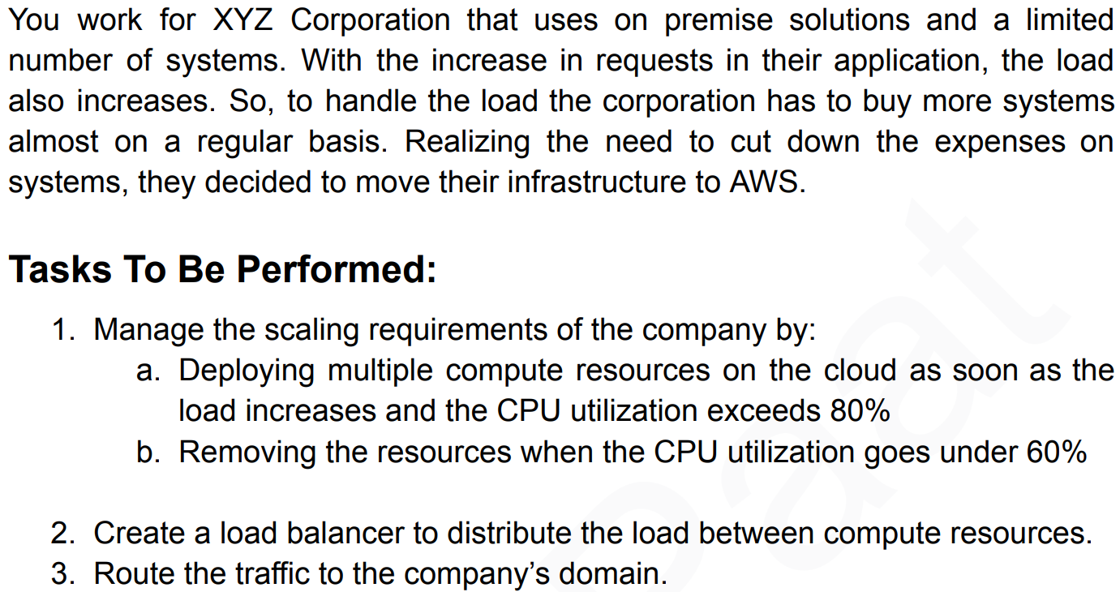
Problem Statement:

Slide 3
Task 1: Manage Scaling Requirements
  Deploying Multiple Compute Resources on the Cloud
    Launch Configuration/Template
    Auto Scaling Group (ASG)
    Create a Load Balancer
  Removing Resources When CPU Utilization Goes Under 60%
Task 2: Route Traffic to the Company's Domain
Steps to be performed:

Slide 4
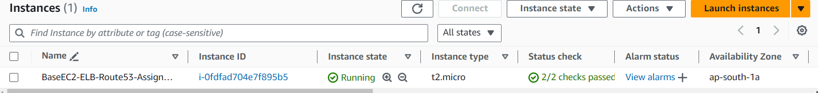
TASK – Manage scaling requirements
a. Deploying Multiple Compute Resources on the Cloud
You can achieve this using AWS Auto Scaling, which automatically adjusts the number of instances in your AWS environment based on demand. Here's how to set it up:
  Launch Template: To create a launch template that specifies the instance type, AMI, key pair, security groups, etc.,
  So, First we’ll create an Instance with a web server and then we’ll create its AMI.
Region: Mumbai Instance Name: BaseEC2-ELB-Route53-Assignment
OS: Ubuntu Instance Type: t2.micro
VPC: MyVPC Subnet: Public Subnet
Auto-assign public IP: Enable
Instance got created. Let’s install a web server with our custom message.

Slide 5
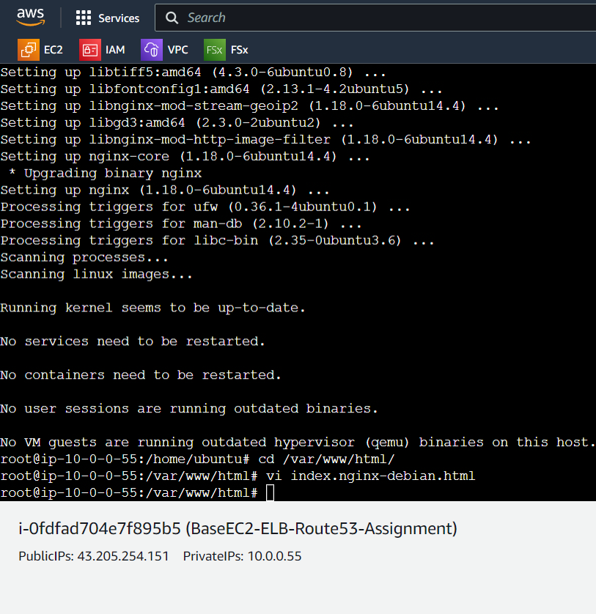
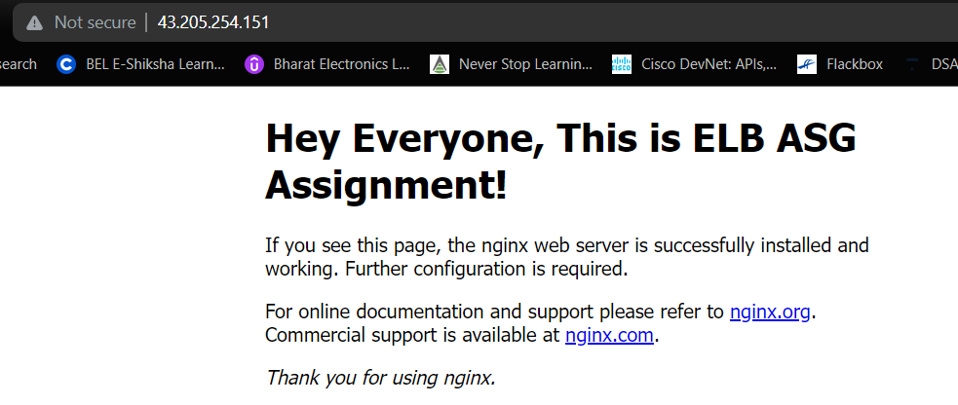
TASK – Manage scaling requirements
Commands executed:
# sudo su
# apt update –y
# apt install nginx –y
# Cd /var/www/html/
Changed h1 of the default web page using vi editor
Output:
(Using the public IP of the base instance)
Our instance is ready for deployment. Let’s create AMI of this.

Slide 6
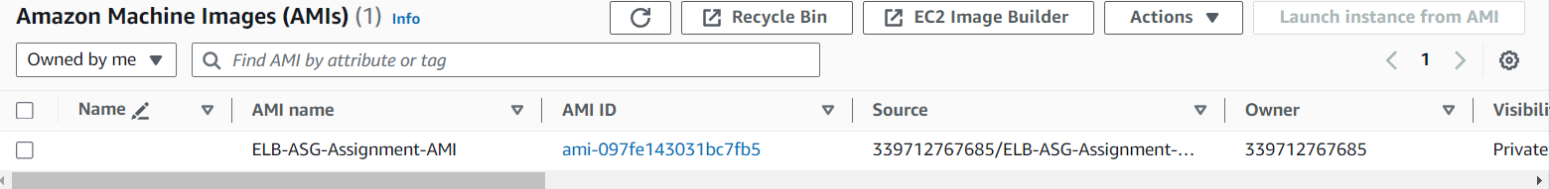
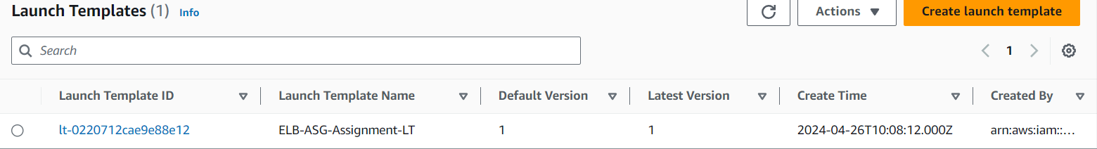
Template version description
TASK – Manage scaling requirements
AMI:
Create a launch template:
Name: ELB-ASG-Assignment-LT OS: MyAMIs → Owned by me → ELB-ASG-Assignment-AMI
Instance type: t2.micro Key Pair name: Don’t include in launch template
Subnet: Don't include in launch template Existing security group: launch-wizard-1

Slide 7
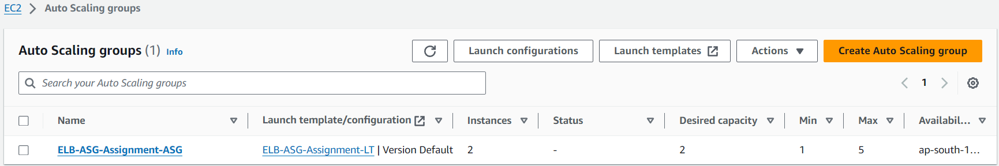
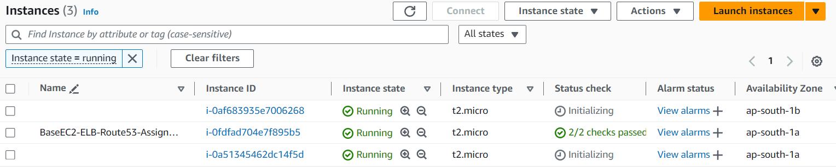
TASK – Manage scaling requirements
Create Auto scaling group, Load Balancer & Target Group:
Name: ELB-ASG-Assignment-ASG Launch Template: ELB-ASG-Assignment-LT
VPC: MyVPC Azs: All Load Balancing: Attach to a new load balancer
Load balancer type: Application Load Balancer Name: ELB-ASG-Assignment-LB
Load balancer scheme: Internet-facing Default Routing: ELB-ASG-Assignment-TG
Group size Desired: 2, Min desired: 1, Max Desired: 5 Replacement behavior: No policy
As soon as the ASG is launched, it created 2 EC2 instances which is our desired capacity.

Slide 8
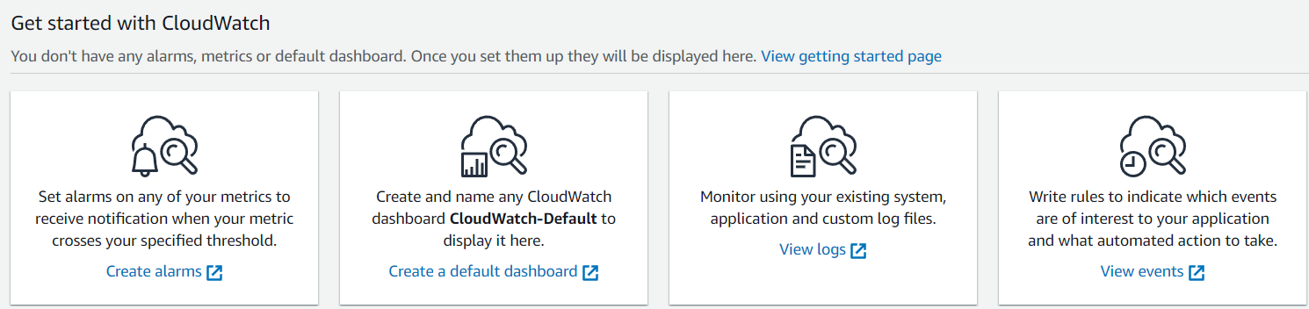
TASK – Manage scaling requirements
We’ll create a Dynamic Scaling policy to:
Deploying multiple compute resources on the cloud as soon as the load increases and the CPU utilization exceeds 80%.
Removing the resources when the CPU utilization goes under 60%
Before proceeding with it, we’ll create cloud watch alarms.
Increasing load alarm 2. Decreasing load alarm
Click on Create alarms

Slide 9
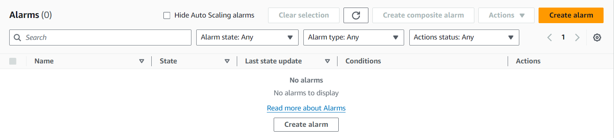
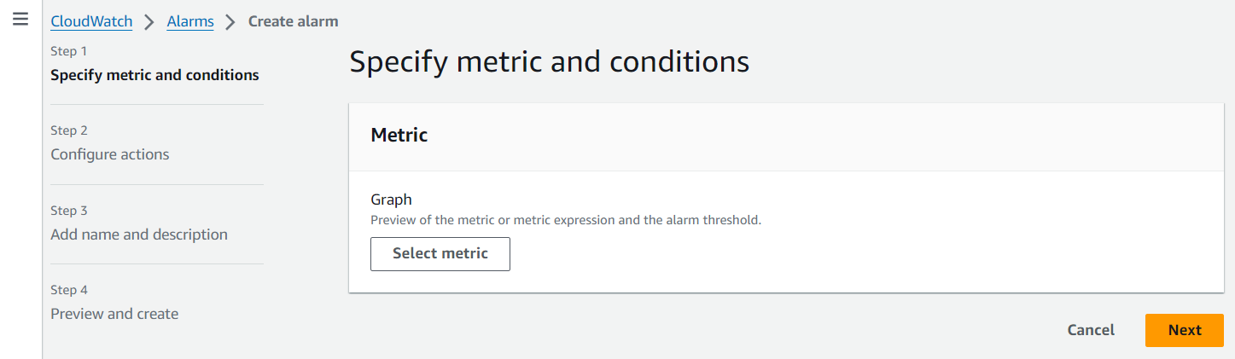
TASK – Manage scaling requirements
Click on Create alarm
Click on Select metric

Slide 10
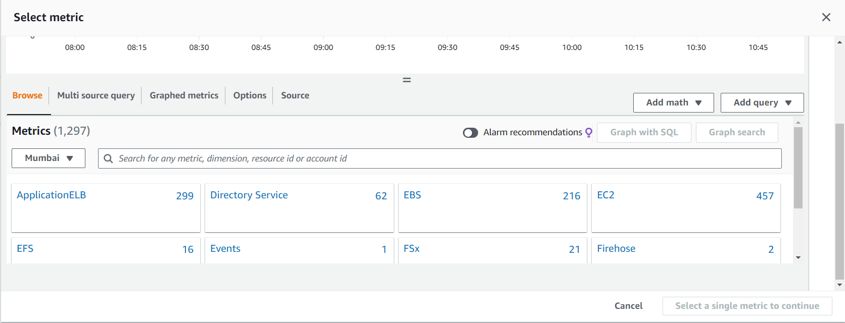
TASK – Manage scaling requirements
Click on EC2

Slide 11
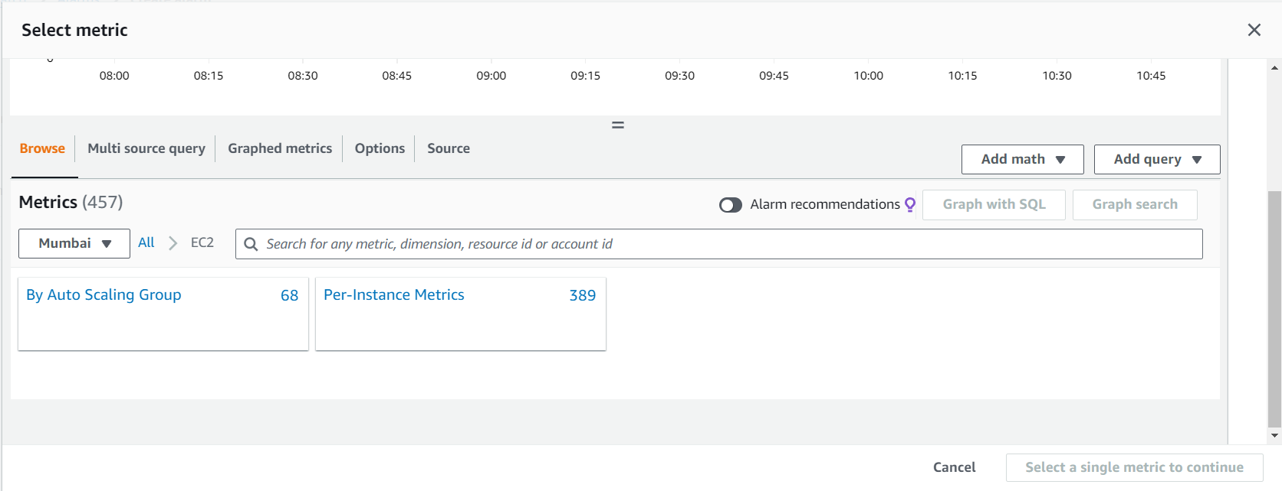
TASK – Manage scaling requirements
Click on ASG

Slide 12
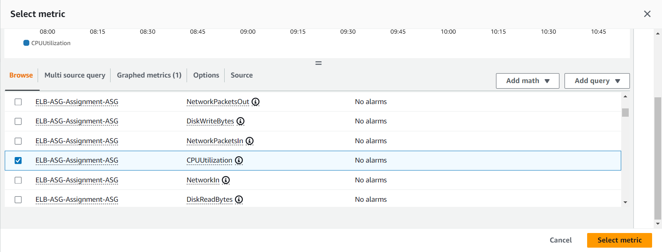
TASK – Manage scaling requirements
Select our ASG with the metric as CPU Utilization then click on Select

Slide 13
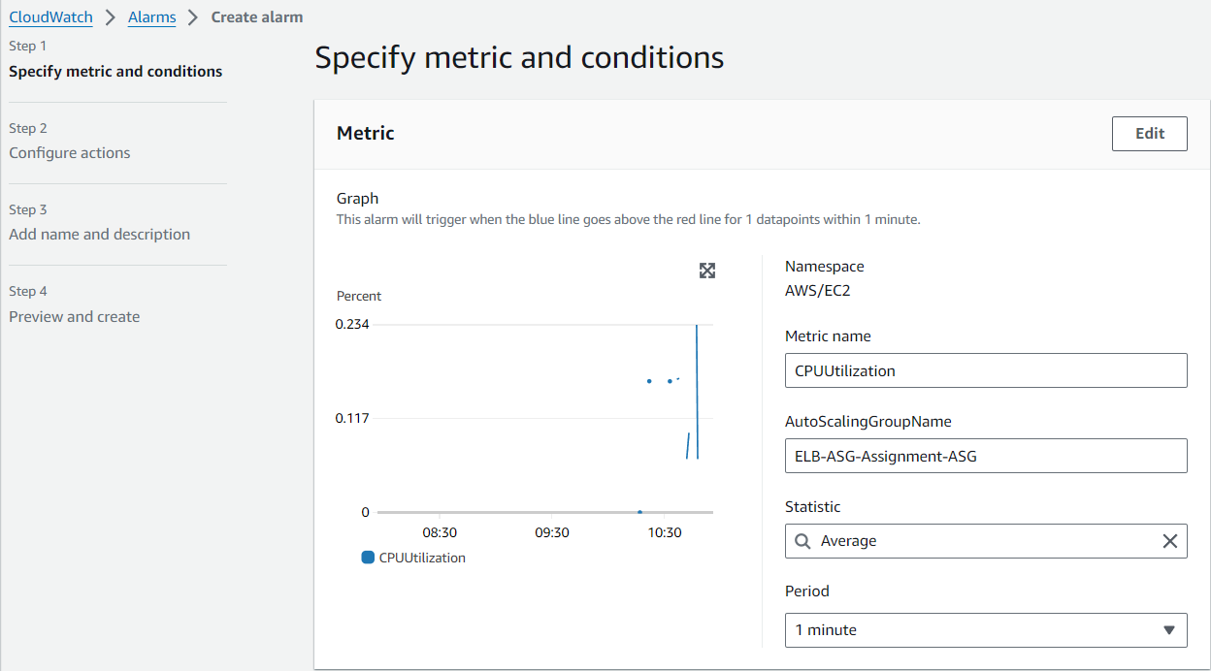
TASK – Manage scaling requirements
Select 1 minute

Slide 14
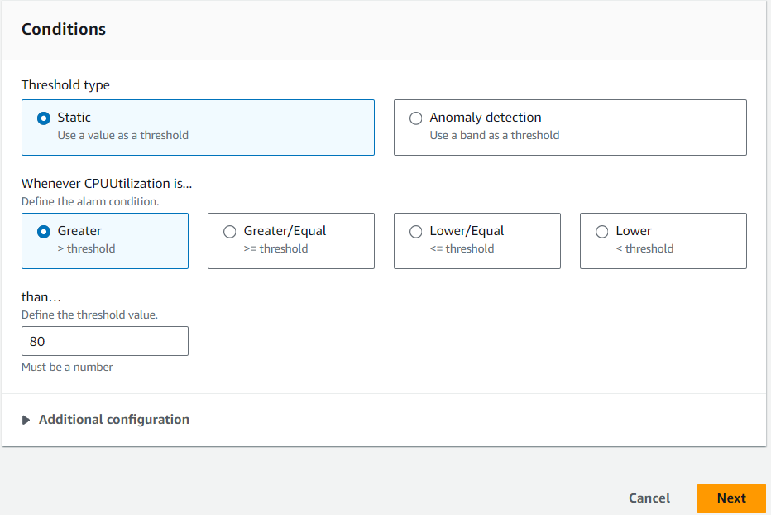
TASK – Manage scaling requirements
Enter threshold value 80 and click Next

Slide 15
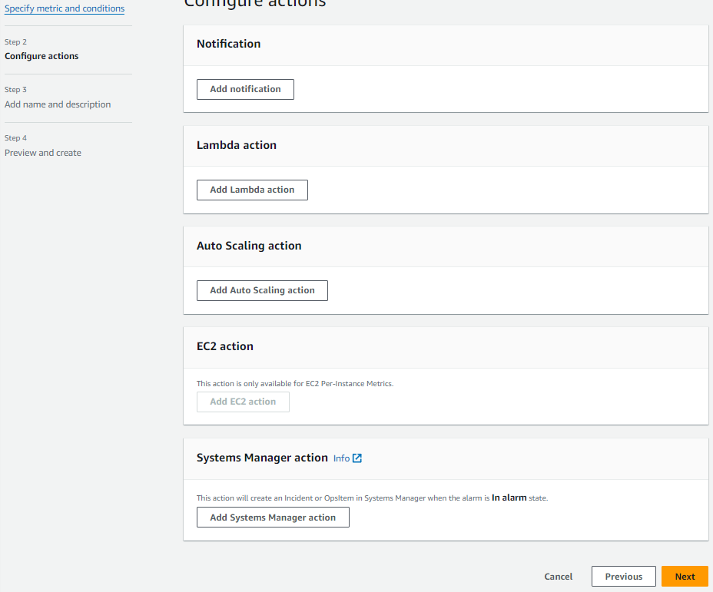
TASK – Manage scaling requirements
Remove if any default notification configuration appears here
Click on Next

Slide 16
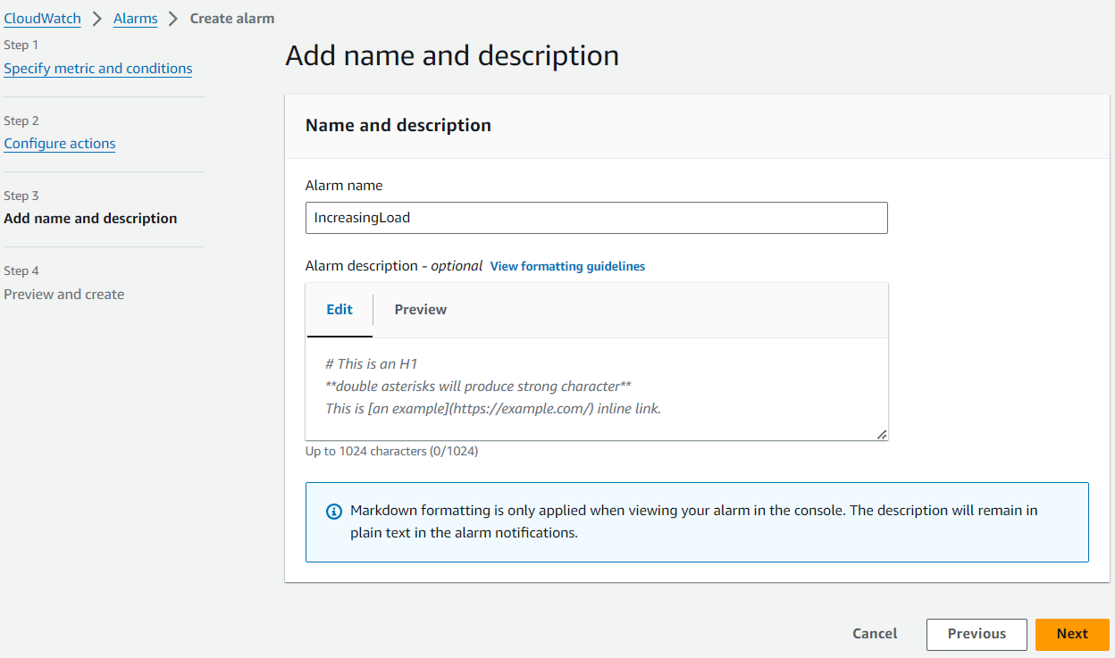
TASK – Manage scaling requirements
Give some name and click on next

Slide 17
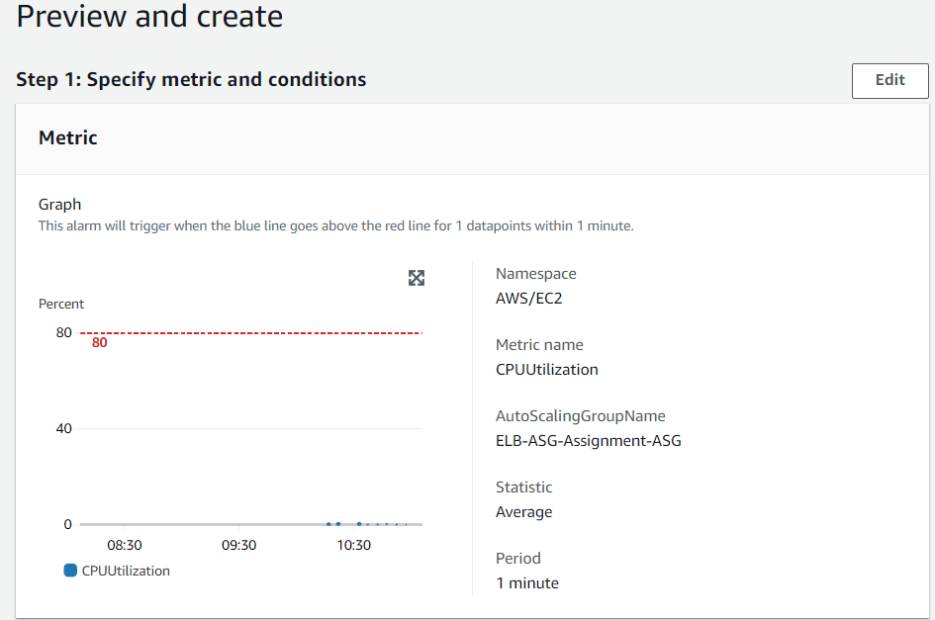
TASK – Manage scaling requirements
Preview the configuration and click on create

Slide 18
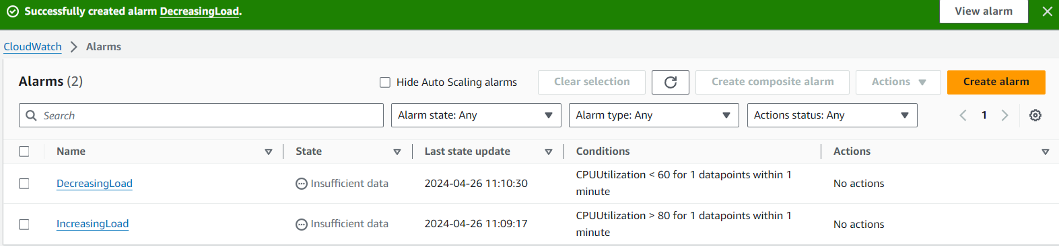
TASK – Manage scaling requirements
Similarly create another alarm for decreasing load.
Both the alarms are created.
Go back to the creation of dynamic scaling policy.

Slide 19
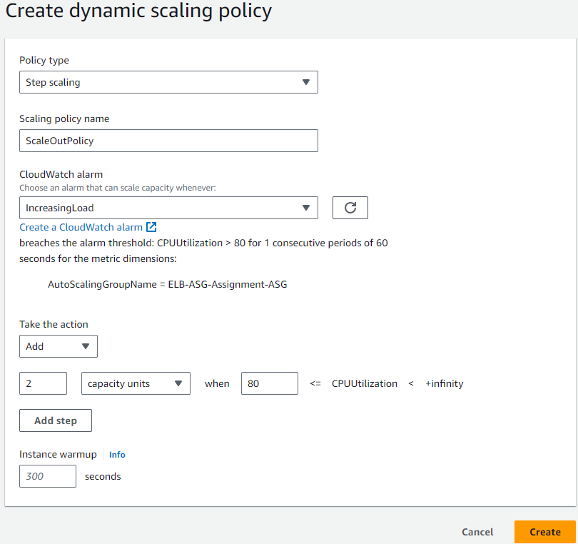
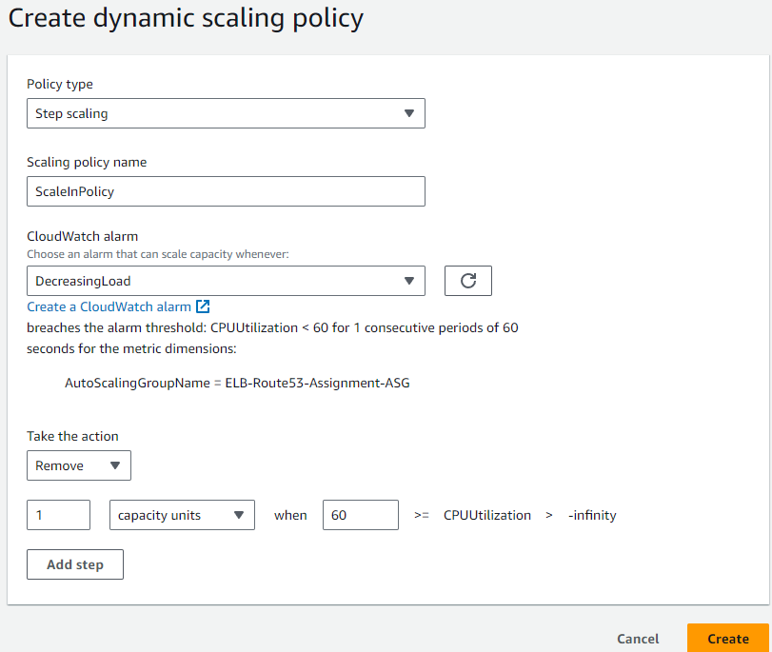
TASK – Manage scaling requirements
Whenever the CPU utilization exceeds 80%, 2 instances will be added
Click on Create
Click on Create
Whenever the CPU utilization goes below 60%, 1 instance will be removed.

Slide 20
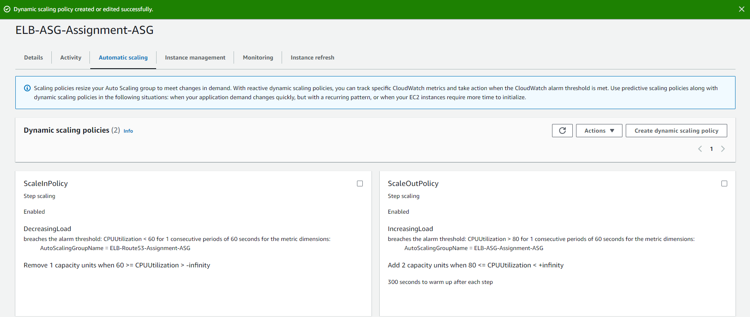
TASK – Manage scaling requirements
Scaling policies added

Slide 21
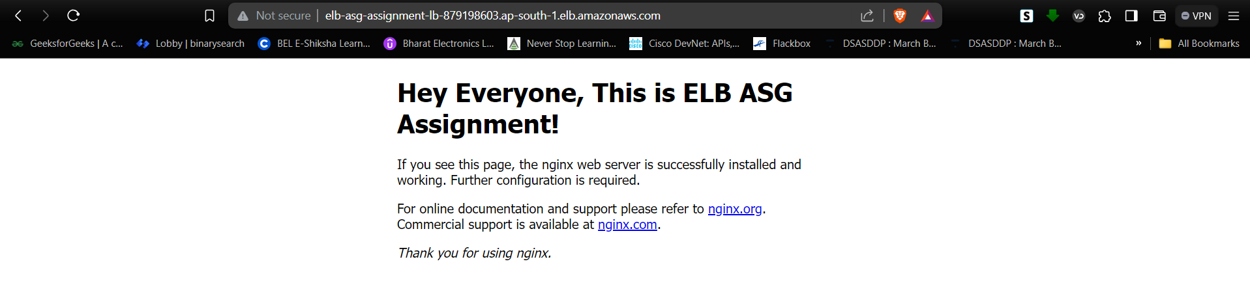
TASK – Manage scaling requirements
Now the web server is accessed using the dns address of the load balancer.

Slide 22
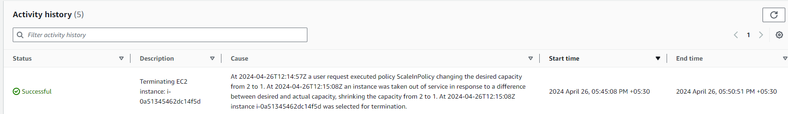
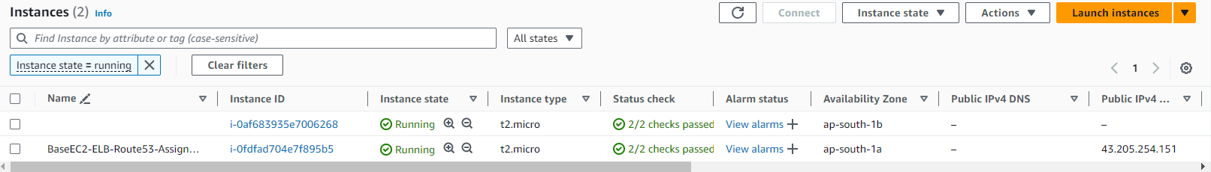
TASK – Manage scaling requirements
As the CPU utilization is less than 60% it terminated one of the instances.
We are left with only one instance from the instances created by the ASG.

Slide 23
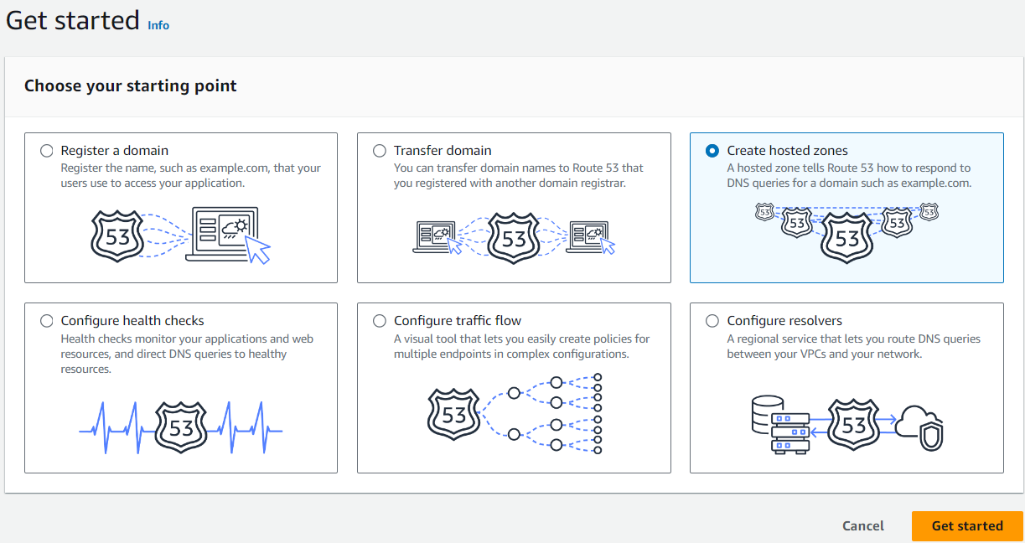
TASK – Route Traffic to the Company's Domain
Let’s route this traffic using the the XYZ corporation’s domain instead of the DNS address. Go to Route53.
Select hosted zone and click on get started

Slide 24
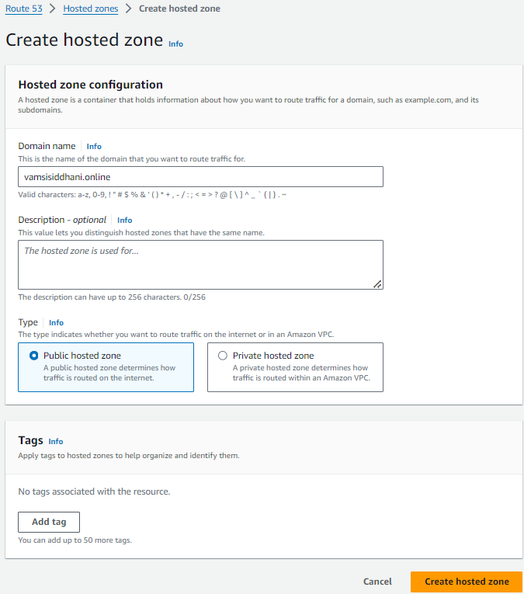
TASK – Route Traffic to the Company's Domain
Assume vamsisiddhani.online is the domain of the XYZ corporation
Enter the domain name and click on create

Slide 25
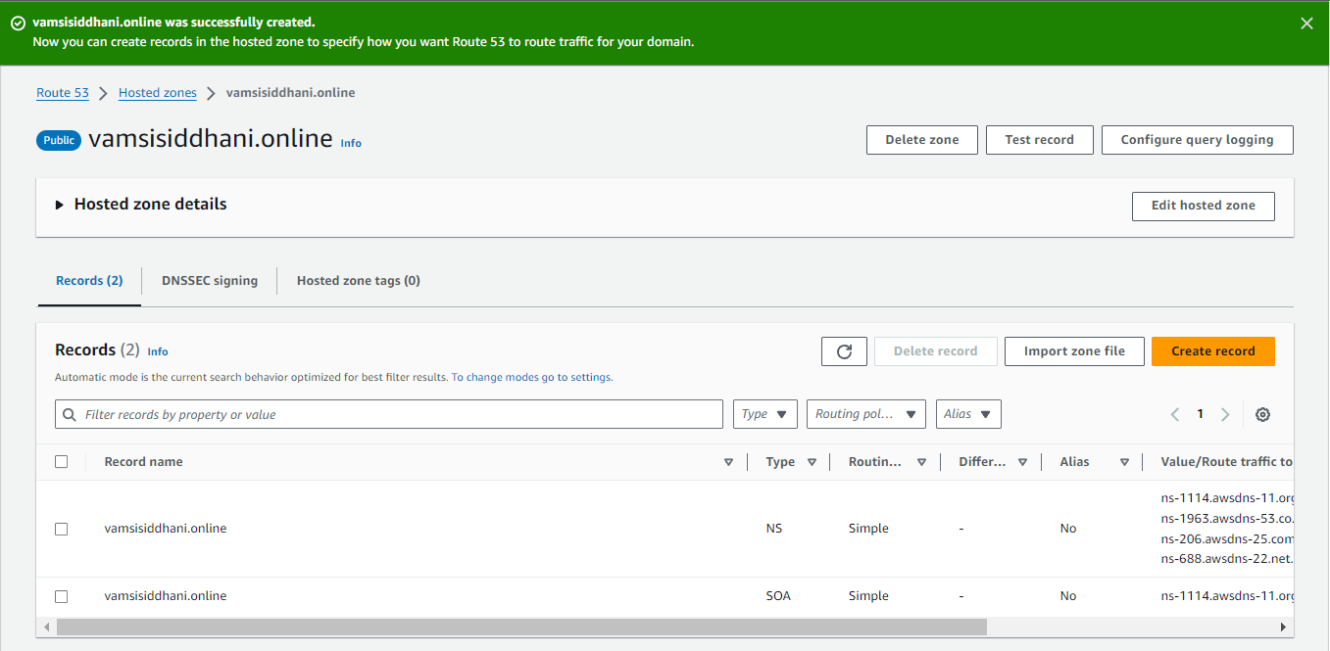
TASK – Route Traffic to the Company's Domain
Hosted zone with the domain got created
By default NS and SOA records will be added
We’ll create a record to connect our load balancer’s DNS

Slide 26
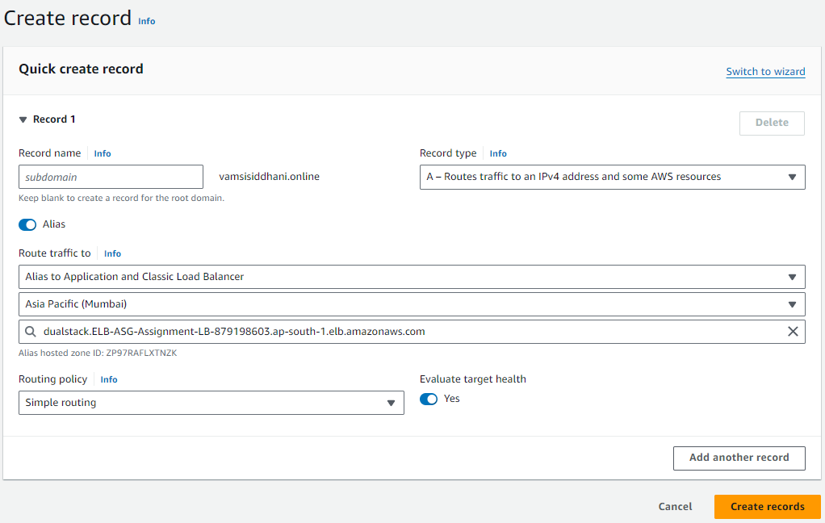
TASK – Route Traffic to the Company's Domain
Select Alias
Select Application Load balancer
Select Mumbai region
Select the load balancer
Click on create record

Slide 27
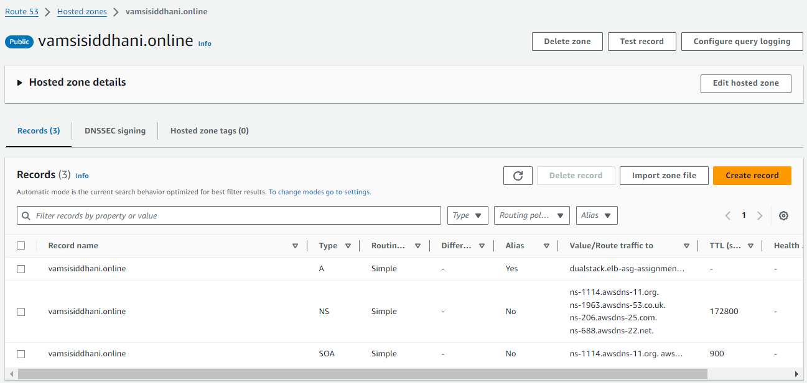
TASK – Route Traffic to the Company's Domain
New alias record got added
Now, we’ll add these name servers in our domain registrar. Go to our account in ionos.com

Slide 28
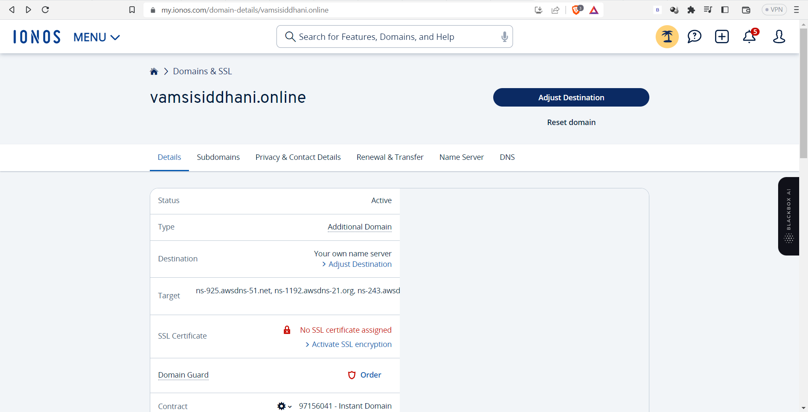
TASK – Route Traffic to the Company's Domain
Let’s go to my account in the domain provider and open the Domain & SSL
Click on Name Server

Slide 29
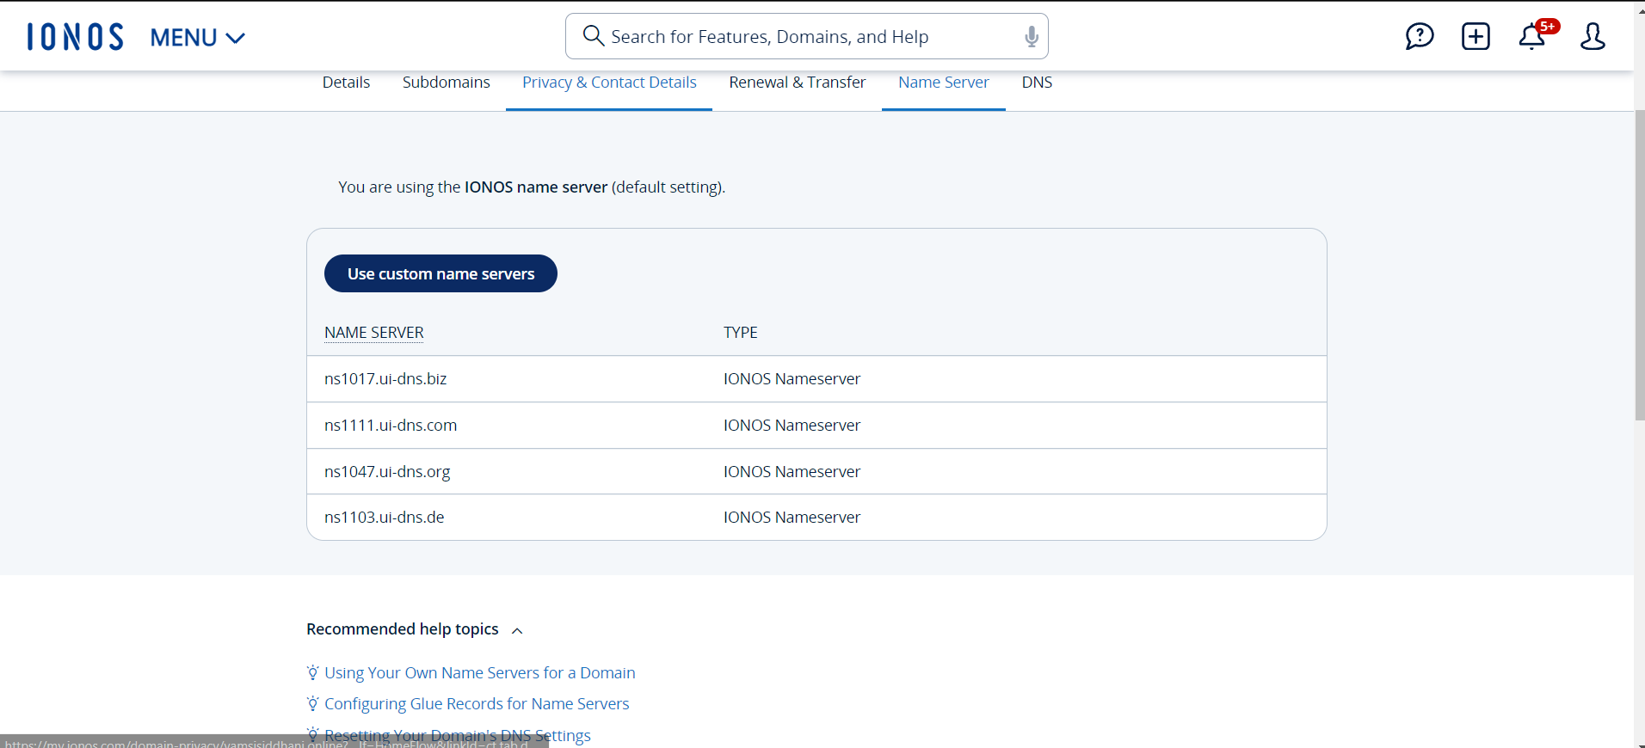
TASK – Route Traffic to the Company's Domain
We’ll replace these default name servers with our name servers
Click on Edit

Slide 30
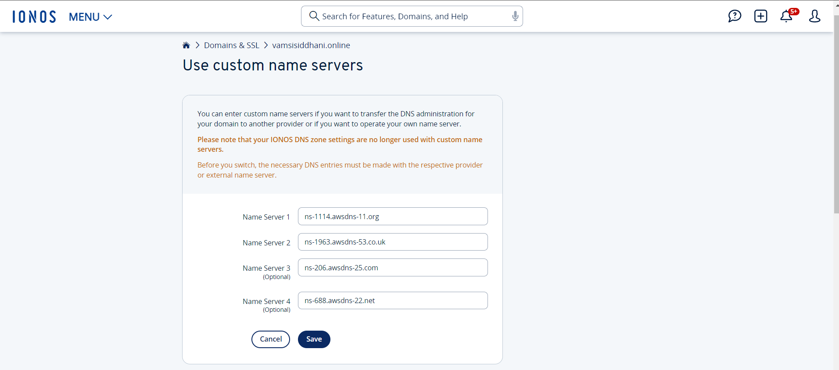
TASK – Route Traffic to the Company's Domain
Click on Save

Slide 31
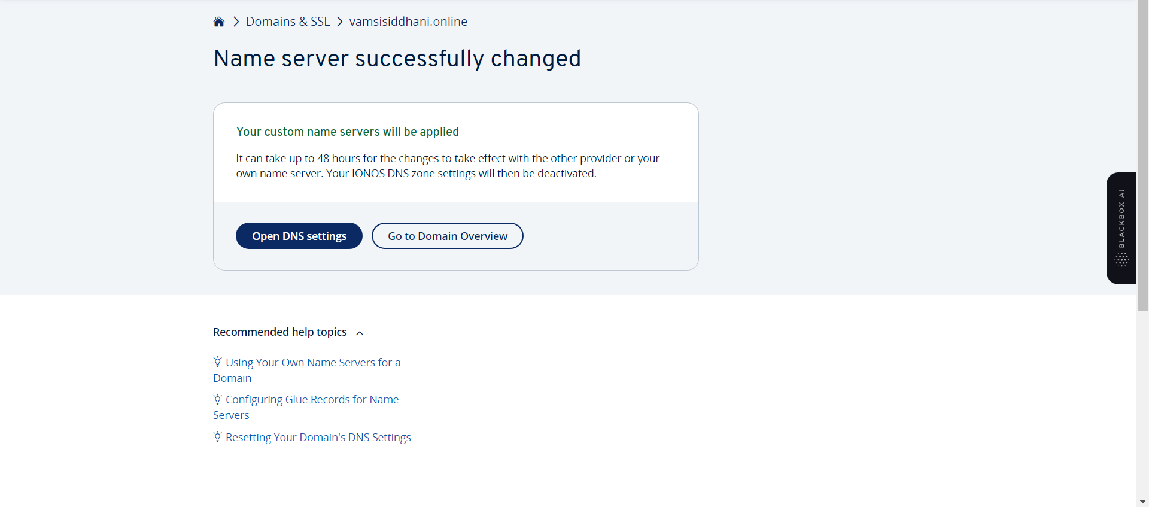
TASK – Route Traffic to the Company's Domain
It may take sometime to apply these changes
After sometime we’ll enter our domain name in the web browser to see if we are able to see the default web page.

Slide 32

TASK – Route Traffic to the Company's Domain
Entered my domain
This completes our assignment.

Slide 33
Summary
Here's a summary of the steps performed:
1. Managed Scaling Requirements:
  Utilized Auto Scaling to automatically adjust compute resources based on demand.
  Set up scaling policies to deploy instances when CPU utilization exceeded 80% and remove instances when it went under 60%.
Created a Load Balancer:
    Used ELB to distribute incoming application traffic across multiple compute resources.
    Created a load balancer, with the configured listeners, target groups, health checks, and DNS settings.
2. Routed Traffic to the Company's Domain:
  Utilized Route 53, to route traffic from the company's domain to the load balancer.
  Created a hosted zone, set up a record set pointing to the load balancer's DNS name, and updated DNS settings with the domain registrar.
By completing these steps, I successfully transitioned XYZ Corporation's infrastructure to AWS, enabling cost savings through efficient scaling, load balancing, and domain routing.

Slide 34

Thank You.

